Slide 1
Management of Technology at Plantronics
Tom Gill – VP and CIO

Slide 2
Agenda
Introduction to Plantronics
Plantronics IT Overview
From Communicate to Collaborate – Our Smarter Working Strategy

Slide 3
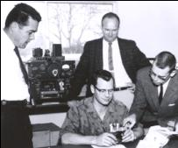
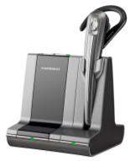
1995
FreeHand, an ultra-lightweight in-the-ear headset, is introduced
1972
Plamex (Plantronics Mexico) opens near Tijuana
1983
The new StarSet Supra soon becomes the call center industry standard
2003
The CS50 brings wireless freedom to the office
2011
Plantronics celebrates 50 years of innovation
1961
Pacific Plantronics is incorporated
1964
FAA selects Plantronics as sole headset provider
1986
Sally Ride uses Plantronics headset in space
2009
Savi Office unifies PC and desk phone communications
1969
First words from the moon spoken through Plantronics headsets
2000
Digitally enhanced USB headsets for the PC and Mac
Notes:
[SLIDE 3: Timeline]
For half a century, we have revolutionized the way people communicate.
Our two cofounders created the world’s first lightweight headset in 1961. In 1969 we helped make history when the first words spoken from the moon were transmitted over a Plantronics headset.
In the ’80s we created the headset that would become the industry standard in call centers around the world—the StarSet Supra. In 1983 we created the first echo-free speakerphone for conference rooms. We were the first to develop digital signal processing headsets—cutting-edge audio technology that reduces background noise to provide enhanced sound quality.
By the ’90s our products were transforming the business environment as office workers adopted our ultra-lightweight, in-the-ear models. By the end of the 20th century, we were perfecting headsets for Internet telephony, multimedia and gaming.

Slide 4
Global Presence
Strong financial position
Annual revenues of over $800 million
Positive cash flow for over 15 years
Headquarters in Santa Cruz, California
Offices in over 30 countries, with major hubs in The Netherlands, China, UK and Mexico
Over 3,600 employees
Leader in contact center, consumer Bluetooth and business communications
Well positioned to take on the growing Unified Communications opportunity
Notes:
[SLIDE 4: Global Presence]
For the past 50 years we’ve experienced many new market opportunities. For each of them, we met the market needs and successfully achieved a leading market share and a new growth trajectory for our revenues.
Our strategic approach is paying off. We have evolved from a successful headset company into a global audio solutions brand. With headquarters in Santa Cruz, California and offices in over 20 countries, we have more than 3,000 employees and hundreds of partners. We have annual revenues of over $600 million globally and, with no corporate debt and a positive cash flow for over 14 years, we are in a rock-solid financial position.
Our track record of developing the right products at the right time has made us a leader in the contact center, consumer Bluetooth and enterprise markets. Today we are uniquely positioned to tackle the expanding Unified Communications market—the future of business communications and the largest revenue and profit opportunity in our company’s history.

Slide 5
100%
of the Fortune 100
Notes:
[SLIDE 5: Leadership In Critical Areas]
Our products are designed to handle the most demanding environments. Our relentless focus on delivering intuitive, high-quality audio products for nearly 50 years has made us a market leader in both consumer and business audio, as well as mission-critical applications.
Today, every company in the Fortune 100 uses our products.
Source: Internal tracking results, 12.1.2010

Slide 6
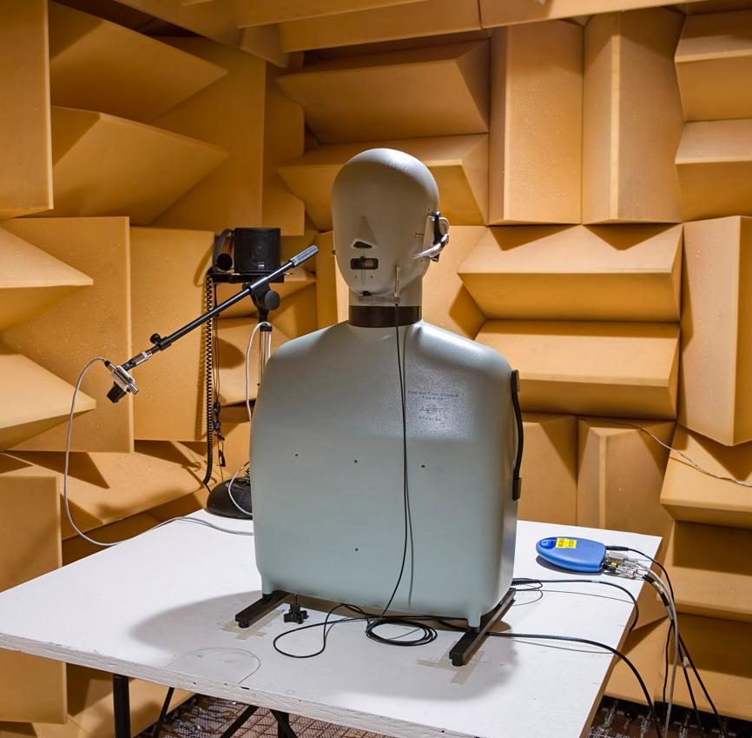
Uncompromising Audio Quality
Over 500 patents
Over 200 engineers
Investment in analytical and psycho-acoustics
Advanced acoustic labs
Pioneers in digital signal processing (DSP)
Design optimized around comfort and sound performance
Notes:
[SLIDE 11: Uncompromising Audio Quality]
Whether we’re designing a Bluetooth headset or an office headset system, we take sound very seriously. We know what goes into making products that deliver superior sound, and it’s far more than a speaker and a microphone. In the case of a headset, we take into account who, how and where it will be used, and then design to deliver the optimal sound experience.
We’ve invested in state-of-the-art, on-site acoustic testing facilities and labs, where the sound engineers put our products through rigorous testing. We research and study sound perception, also referred to as psychoacoustics, a branch of science that studies the psychological and physiological responses associated with sound.
Our designs are inspired by the human form. Recognizing the fact that not all ears are created equal, we have conducted extensive research into variations of the human ear. Our designers test our headsets on a “wall of ears”—nearly 2,000 silicone molds of ears that test the balance, fit and acoustic seal of our headsets. The result is the lightest possible headset design that fits 97 percent of all ears comfortably.
With more than 500 design and utility patents and over 200 engineers pioneering methods in acoustics, our pursuit of communication technologies that simplify our lives is never-ending.

Slide 7
Premier Audio Technology for Mission-Critical Applications
The preferred headset for:
NASA mission control
Air traffic controllers
Emergency dispatch
New York Stock Exchange
Call centers worldwide
7
Notes:
[SLIDE 12: Premier Audio Technology for Mission-Critical Applications]
We supply the majority of headsets for NASA mission control and ground-based operations. We have been the exclusive provider of headsets for U.S. Federal Aviation Administration air traffic controllers for nearly five decades. Plantronics is the headset of choice for emergency dispatch, the New York Stock Exchange, and call centers around the world.

Slide 8
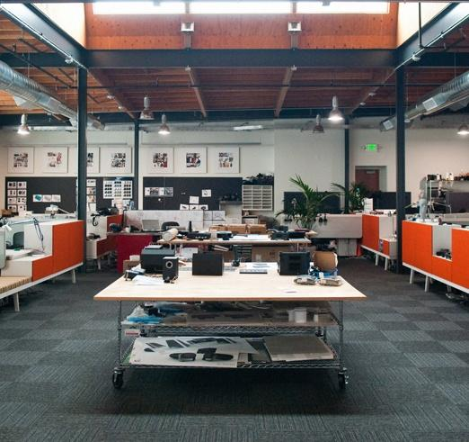
Intuitive Design Excellence: A Strategic Investment
Award-winning industrial design team
More than 20 designers on staff
8,000-square-foot design center
Pioneers in materials, fit and comfort
Experts in human behavior, anatomy and ergonomics
Notes:
[SLIDE 13: Intuitive Design Excellence: A Strategic Investment]
As part of our strategic investment in design, we opened an 8,000-square-foot design center at our headquarters in Santa Cruz, California. There, our design team treats the human form as a canvas from which to begin the inspiration process, creating iconic products that win prestigious awards and capture the consumer imagination.
We bring a human-inspired approach to every product we make. Our expertise in human behavior, anatomy and ergonomics, color, proportion and complex surface development converge in the design of advanced products that look beautiful and become extensions of the body.
Our insights into our customers’ diverse needs help us develop intuitive, comfortable products that facilitate communication, are easy to operate and satisfying to use, every single time.

Slide 9
Information Technology at Plantronics
Tom Gill

Slide 10
Plantronics IT
Global team providing services to 20+ countries from four regional hubs
Santa Cruz Corporate Headquarters
Wootten Bassett UK supporting Europe, Middle East and Africa
Suzhou China supporting Asia Pacific Region
Tijuana Mexico supporting our manufacturing and managed services center
Highly collaborate team focused on global standards and solutions
Most all meetings are audio, video and web conferences
Time zone, language and cultural differences make it interesting!
End user experience should be the same regardless of location
Great support from our Executive Staff
CEO, CFO, CMO, CTO, etc.
Strong partnerships with all business units and functions

Slide 11
Plantronics IT
Key infrastructure vendors and solutions include
Cisco Networks
Dell Servers (75% virtualized)
Avaya Call Center Systems
Microsoft Office, Exchange, Skype for Business
VMWare and Citrix Virtualization Platforms
Client systems including laptops, smartphones and tablets
Business applications include
Oracle Business Apps including supply chain, finance, HR, customer support, product lifecycle management, forecasting and financial planning
Microsoft Sharepoint and Enterprise Program Management
Salesforce.com for sales, marketing and customer support
Jive social for business
Over 200 services including many cloud based solutions

Slide 12
Plantronics IT – Key Roles and Competencies
Roles
Project Managers
Business Analysts
Application Developers
Database Administrators
System and Storage Administrators
Network Engineers
Information Security Analysts
Service Desk Technicians

Slide 13
Plantronics IT - Challenges
Consumerization of IT
Bring your own device (BYOD)
Cloud services (BYOA)
Our job is to manage the technology and not to say “no”
Changing malware threat landscape
Signature based vs. targeted is current trend
Protecting intellectual property, employee and customer information
High demand for IT services!
Ensuring consistent systems and processes worldwide

